Slide 1


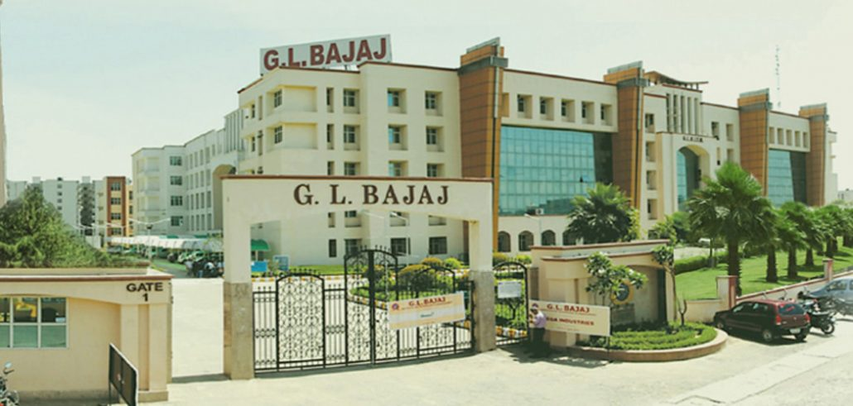
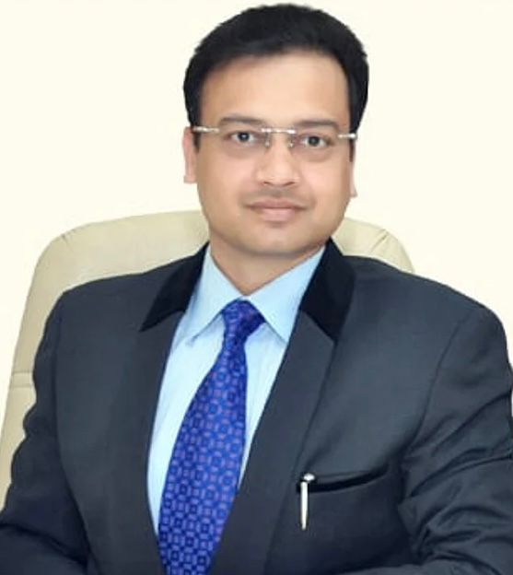

E- volve
“Bi Monthly Finance Magazine”
Vol-2, issue-5, month Sept-Oct
Chief Patron
Shri Pankaj Agarwal
(Vice Chairman)
Patron
Dr. Sapna Rakesh
(Director GLBIMR)
Faculty Coordinators
Dr. Shuchita Singh
(Associate Professor)
Corporate Mentor
Mr. Sumit Gulati
(Founder of FINEXCELACADEMY)

Slide 2
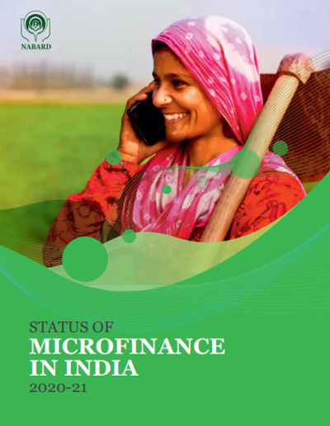

Slide 3
MICRO-FINANCE ?
KEY TAKEAWAYS:-
Micro-finance is a banking service provided to unemployed or low-income individuals or groups who otherwise would have no other access to financial services.
Micro-finance allows people to take on reasonable small business loans safely, and in a manner that is consistent with ethical lending practices.
The majority of microfinancing operations occur in developing nations, such as Uganda, Indonesia, Serbia, and Honduras.
The World Bank estimates that more than 500 million people have benefited from microfinance-related operations
Micro-finance, also called microcredit , is a type of banking service provided to unemployed or low-income individuals or groups who otherwise would have no other access to financial services.
While institutions participating in the area of micro-finance most often provide lending—micro-loans can range from as small as $100 to as large as $25,000—many banks offer additional services such as checking and savings accounts as well as micro-insurance products, and some even provide financial and business education. The goal of micro-finance is to ultimately give impoverished people an opportunity to become self-sufficient.

Slide 4
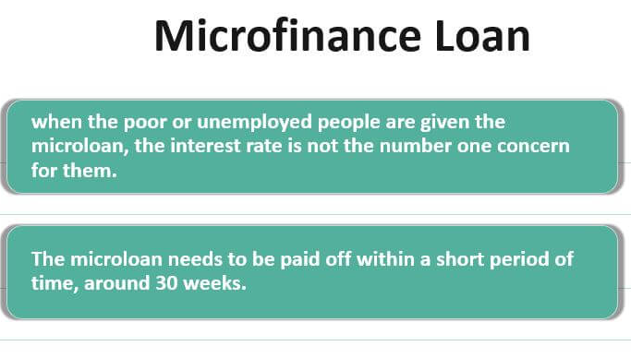
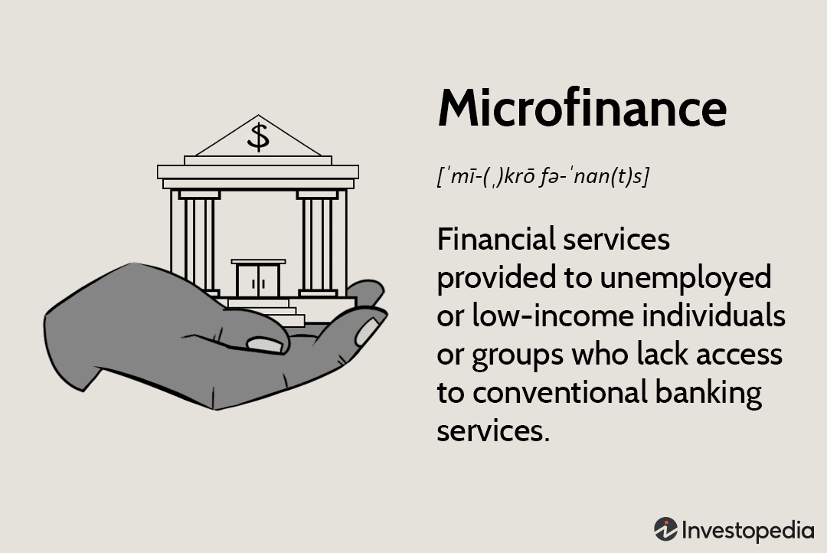
What criticisms have been made of microfinance?
While micro-finance financing costs are for the most part lower than regular banks', pundits have charged that these tasks are bringing in cash off of poor people. Likewise, many major monetary organizations and other huge enterprises have sent off for-benefit micro-finance divisions raising worries that, out of a craving to bring in cash, these bigger financiers will charge higher loan costs that might make an obligation snare for low-pay borrowers.
Moreover, some have contended that individual micro-loans are insufficient cash to give a reasonable way to freedom. At last, pundits have said that the presence of interest installments, but low, is still a burden.

Slide 5
Global Microfinance Figures
Focus on institutions and clients
In ten years, microfinance institutions (MFIs) have lent hundreds of billions of dollars, with an average annual growth rate of 11.5% over the past five years. At the same time, the number of borrowers worldwide continued to increase – albeit at a slower pace than in the 2000 to 2010 period – recording an average annual growth rate of 7% since 2012, compared to a rate of nearly 20% in the previous decade.
In 2018, 139.9 million borrowers benefited from the services of MFIs, compared to just 98 million in 2009. Of these 139.9 million borrowers, 80% are women and 65% are rural borrowers, proportions that have remained stable over the past ten years, despite the increase in the number of borrowers. With an estimated credit portfolio of $124.1 billion, MFIs recorded another year of growth in 2018 (+8.5% compared 2017)

Slide 6

Role of Micro Finance In India
Microfinance is a banking service that gives unemployed low-income people or groups access to financial services that they would not otherwise have.
People can obtain acceptable small business loans through microfinance in a secure manner that adheres to moral lending principles.
Most microfinance transactions take place in underdeveloped countries including Uganda, Indonesia, Serbia, and Honduras.
India’s microfinance loan portfolio stands at ₹3 lakh crore with 6 crore unique borrowers:
The gross loan portfolio for the microfinance sector increased by 23.5% annually to 2.93 lakh crore as of June 30, 2022 from 2.37 lakh crore the previous year.
A microfinance loan is defined by the Reserve Bank of India as a collateral-free loan granted to a household with an annual household income of up to 3 lakhs.
The rise of globalizations and liberalization in India in the early 1990s made the issue of women, Working in unorganized sectors is much worse because the majority of the women who were involved in various self-employment activities have now lost their means of support. Despite the fact that women make a significant contribution to the home and national economies, their labor is still seen as merely an extension of domestic duties and is not paid for. Self Help Groups (SHGs) have dominated the microfinance industry in India as a successful method of providing financial services to the "Unreached Poor.“

Slide 7
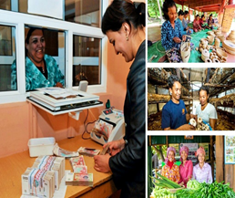

The top 10 microfinance institutions in India are:
Annapurna Microfinance Pvt Ltd.
Arohan Financial Services Pvt. Ltd.
Additionally, Asirvad Microfinance Pvt Ltd
Bandhan Financial Services Private Limited
BSS Microfinance Private Limited
Paycor Micro Credit
Disha Microfin Private Limited
Equitas Microfinance Private Limited
ESAF Microfinance and Investments, Pvt.
Fusion Microfinance Private Limited
Benefits of Microfinance:
The World Bank estimates that over 500 million people have benefited directly or indirectly from microfinance-related activities.
By 2021, more than 120 million people will have directly benefited from microfinance-related activities, predicts the Consultative Group to Assist the Poor, an international nonprofit organisation with headquarters in Washington.
Source: Asian Development Bank

Slide 8
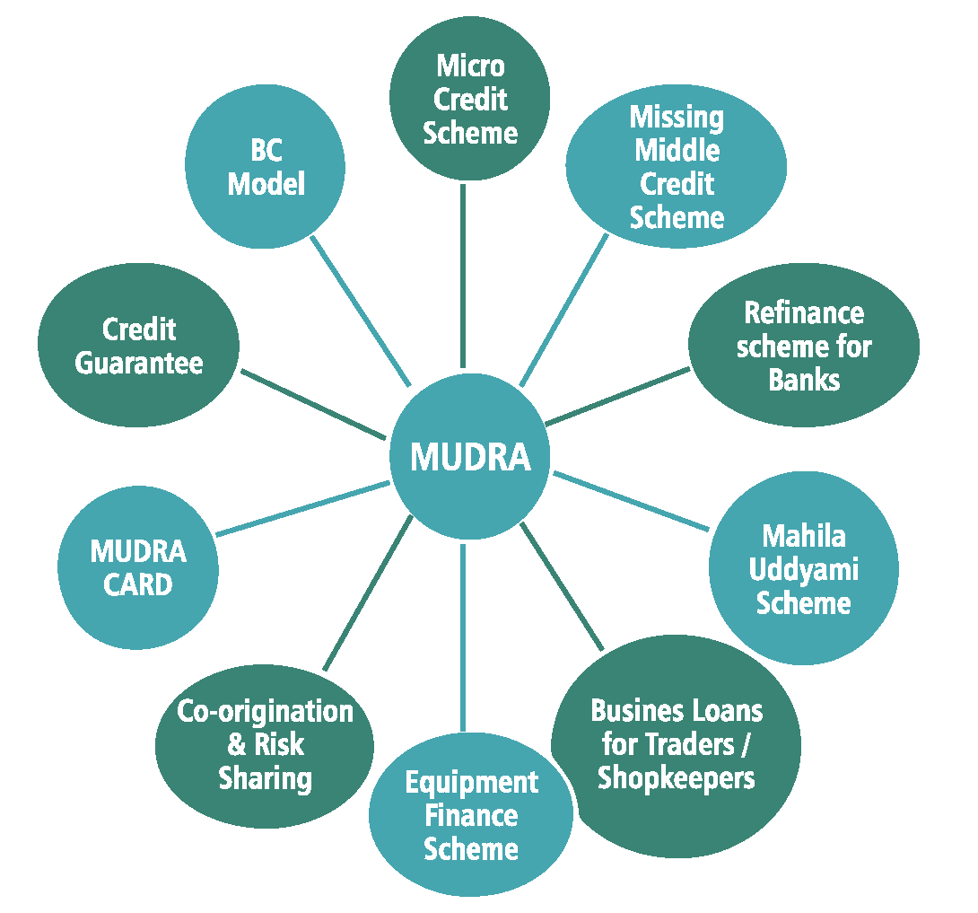

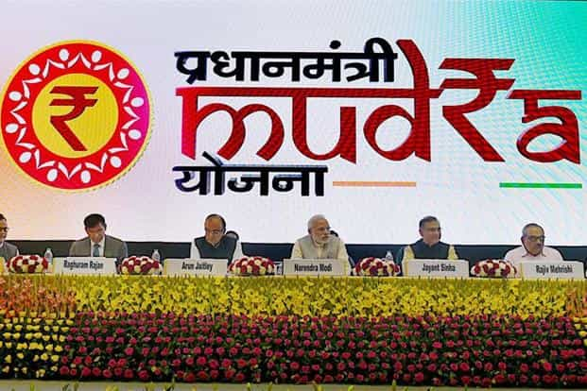
MUDRA (MICRO UNITS DEVELOPMENT REFINANCE AGENCY) Bank
Refinancing programme for up to Rs. 10 lakh in collateral-free loans from the central government Loans fall into one of three categories:
Shishu loans are up to Rs. 50,000, and Kishor loans are between Rs. 5001 and Rs. 5 lakhs. Tarun lends between a lakh and ten lakh rupees.
References include the website of the RBI and Investopedia.

Slide 9

Helping hand US Development Finance Corp to support financial inclusion, clean energy projects
The US Government’s Development Finance Corporation (DFC) is looking to focus on investments pertaining to financial inclusion and clean energy in India, according to CEO Scott Nathan, who is on a three-day visit to India.
The US DFC, on Tuesday, announced a seven-year, $35-million loan to Credit access Grameen -- the country’s largest NBFC-MFI, to help grow its reach to marginalised women and encourage more women into employment and leadership in microfinance.

Slide 10
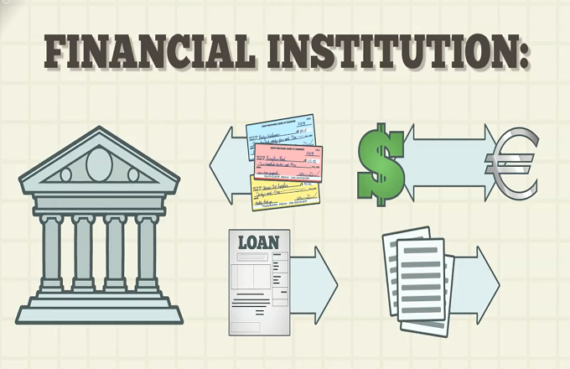
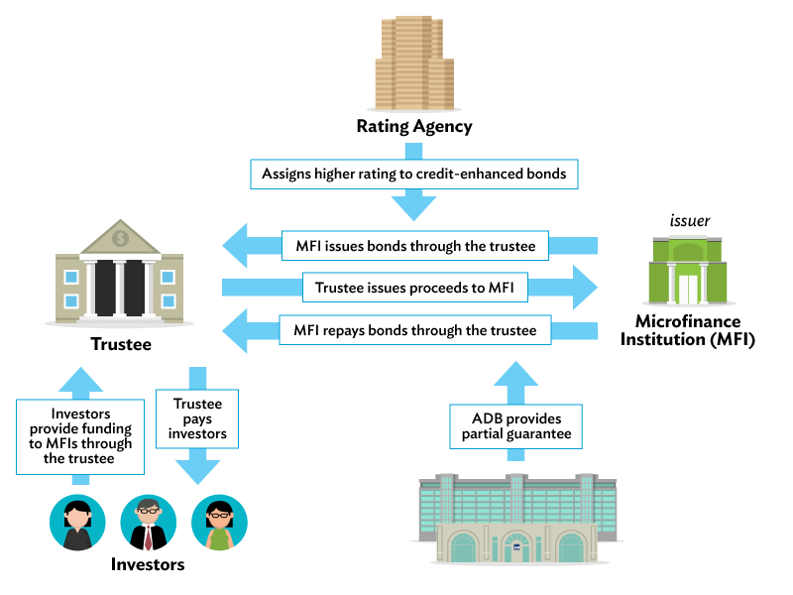

The government agency has signed an agreement for a $10-million loan guarantee for Punjab Renewable Energy Systems, which will help fund the construction of seven biomass plants. It has also committed $30-million for an agri tech fund and $10-million to a milk company,
Nathan said.
The DFC has so far committed $3-billion to private Indian enterprises since formation in 2019. The agency will also announce investments in the healthcare segment during the New Delhi-leg of Nathan’s visit, in addition to other focus areas such as digital and physical infrastructure.
Refrence:https://www.thehindubusinessline.com/news/us-development-finance-corp-to-support-financial-inclusion-clean-energy-projects/article66027573.ece

Slide 11
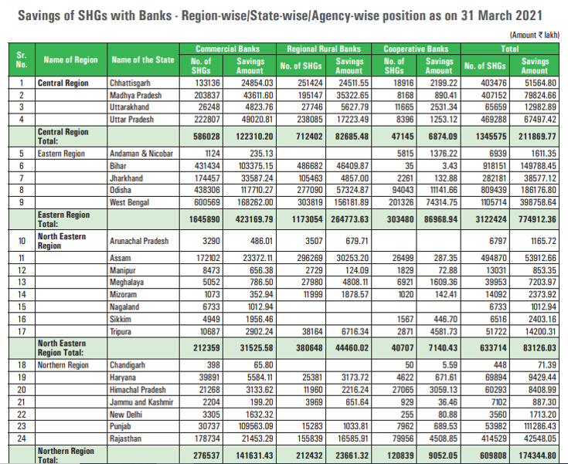

Slide 12
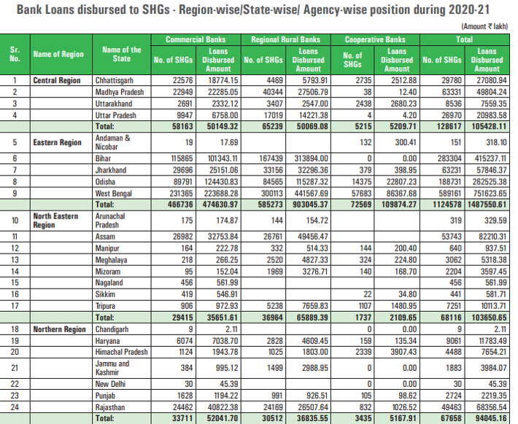

Slide 13



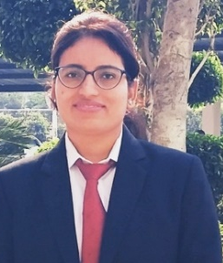

EDITORIAL BOARD
Winner Of Last Magazine
Sakshi Jaiswal
PGDM22263
Sakshi.jaiswal2022@glbimr.org
Ashutosh Kumar
PGDM22054
Ashutosh.kumar2022@glbimr.org
Rajani Dubey
PGDM22386
Rajani.dubey2022@glbimr.org
Pallavi Dixit
PGDM22088
Pallavi.dixit2022@glbimr.org
CONGRATULATIONS
FILL THE FORM, TO BE A PART OF EDITORIAL COMMITTEE FOR THE UPCOMING FINANCE MAGAZINE.(ARTICLE TOPIC G20)
LINK IS GIVEN BELOW
Tanya Gupta
PGDM22262
SEC - D
https://forms.gle/rcGnWVVx3jrLUA3x7

Slide 14


SOMETIMES YOU LEARN, SOMETIMES YOU WIN.
TIME TO PLAY WITH WORDS
1)A little loan that is typically given to those with low incomes
2)Alternative to Microfinance –
3)A bill of exchange in which one party instructs the bank to transfer money to the other party's bank account –
4)A type of debt incurred by a person or another organization –
5)A finalized agreement between a seller and a buyer for the exchange of products, services, or financial assets –
6)A market index introduced by the National Stock Exchange –
7)A place where shares of pubic listed companies are traded –
JUMBLE CLUES
PRESS LINK FOR ANSWERS
https://docs.google.com/forms/d/e/1FAIpQLScr9EVoqLI3pufthuomw_kGLYhXwWv0ubZcTmbAbSBquL0Wxg/viewform
1)Fmcrinconaec
2)liocmrdcert
3)chqceu
4)noal
5)rsaiotcntnIfnyt
6)fniyt 7)etacrsmkokt

